Slide 1
Multi - Agentic AI Frameworks
Course Code: MMAAI
Dr.S.Mahesh Anand

Slide 2
AI Agents Vs Agentic AI
Think of an AI agent as a smart helper program or robot.
It gets a goal from you (like "book a ticket" or "answer this question"), looks at information it has, and tries to do that one job for you.
Agentic AI takes things to the next level.
It acts more like an independent helper that can think, plan, break up complex tasks into steps, use tools (like calculators, search engines), learn as it goes, and even reflect on its performance to improve.
In short:
AI agents are smart, single-task helpers.
Agentic AI is a super-helper it can plan, adapt, and handle complicated jobs by itself, almost like a human thinking things through for you.

Slide 3
Key Difference
AI agent: Does one request at a time follows orders.
Agentic AI: Handles complex, multi-step tasks can plan, adapt, and improve itself, working more like a thoughtful human assistant.

Slide 4
Agentic AI Frameworks
LangChain/LangGraph:
Still the most widely adopted, broadest ecosystem; excellent for starting points.
CrewAI, AutoGen:
Both are state-of-the-art for collaborative, specialized, and distributed agent systems.
Agno/alternative is Haystack
Up-and-coming, especially relevant for RAG the "hot" subfield in enterprise AI.
n8n:
Popular for bridging automation and AI agent workflows, used in startups to enterprises.
Note: Pydantic is a modeling library, not an agent framework. Pydantic is used for data validation/structuring

Slide 5
Mainstream: LangChain, LangGraph & n8n
Research: (Autogen, Agno & MCP)
CrewAI is gaining momentum in the developer community, but its ecosystem is not as wide or mature as LangChain/LangGraph.

Slide 6
LangChain
A library for chaining together LLMs, prompts, memory, and tools, supporting easy integration with popular LLM models.

Slide 7
Lab1 : Building a ReACT-Loop Conversational Agent With Tools
Agent
Definition: In LangChain and LLM applications, an agent is an AI component that makes decisions about which “tools” or actions (such as calculation, searching, or calling APIs) to use and responds to natural language queries by reasoning step-by-step.
Need: Agents enable LLM-powered workflows to go beyond static text generation and perform dynamic, multi-step tasks (e.g., calculations, looking up information, and combining intermediate results).

Slide 8
Prompt Engineering &
ReAct Loops
Definition: ReAct (Reason–Act) is a prompting pattern where the model reasons ("Thought"), chooses an action ("Action"), pauses for an observation ("PAUSE"), processes the observation ("Observation"), and finally produces an answer ("Answer").
Need: This structure breaks complex queries into sub steps, improves transparency, and enables tool-using agents to reason more like humans.

Slide 9
Tools/Actions
Definition: Functions external to the LLM that the agent can call for real-world effect, such as:
  calculate: A Python-based calculator.
  average_electricity_cost: Returns average electricity cost per Indian state.
  ingredient_quantity: Estimates food quantities for people, using Indian norms.
Need: Allows the agent to answer questions that require computation, lookups, or logic outside the LLM’s core capabilities.

Slide 10
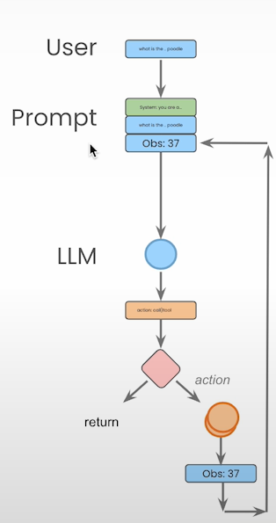

Slide 11
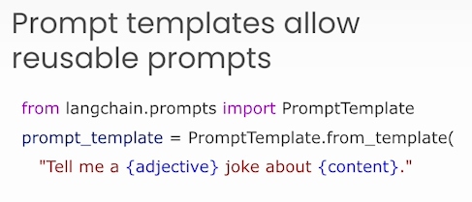
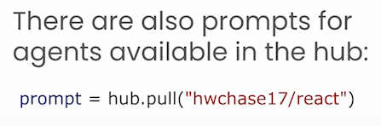
LangChain Prompts

Slide 12
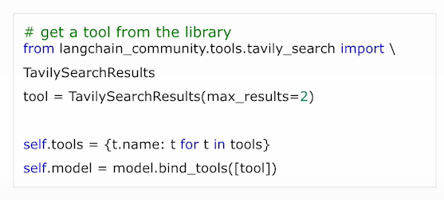
LangChain Tools

Slide 13
Lang Graph
LangGraphs is an extension of LangChain that supports Graphs
Single and Multi-agent flows are described and represented as Graphs
A framework for structuring LLM-based workflows as directed graphs. Each node is a “step” (e.g., call model, run tool), and edges define conditional logic and data flow.
Allows for extremely controlled “flows”
Allows building complex, multi-step reasoning agents with easily modifiable logic and clear data/state management.
Built-in persistence allows for human-in-the-loop workflows

Slide 14
Graph Nodes & Conditional Edges
Nodes represent individual operations (like LLM calls or tool invocations); edges determine how execution moves state fully based on outputs (e.g., did model request a tool?)
Enables decision branches, loops, and flexible multi-step queries.

Slide 15
Cyclic Graphs
Persistence
Human-in-the-Loop

Slide 16
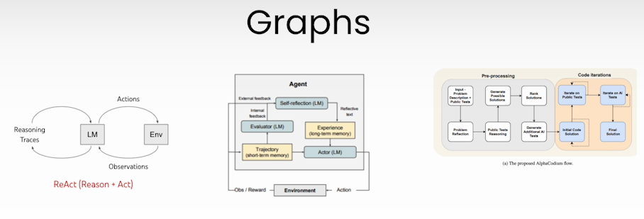
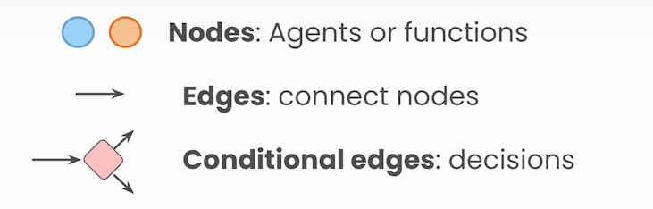

Slide 17
Lab4 demonstrates how to build a more advanced, modular AI agent using graph-based workflows LangGraph together with LangChain and OpenAI APIs
Building agent state and workflows as a directed graph.
Integrating external tools (search engine via Tavily).
Handling multi-step complex queries (e.g., information lookup, sequential tool use).
Creating a conversational research assistant that can reason, access tools, and return composed answers.

Slide 18
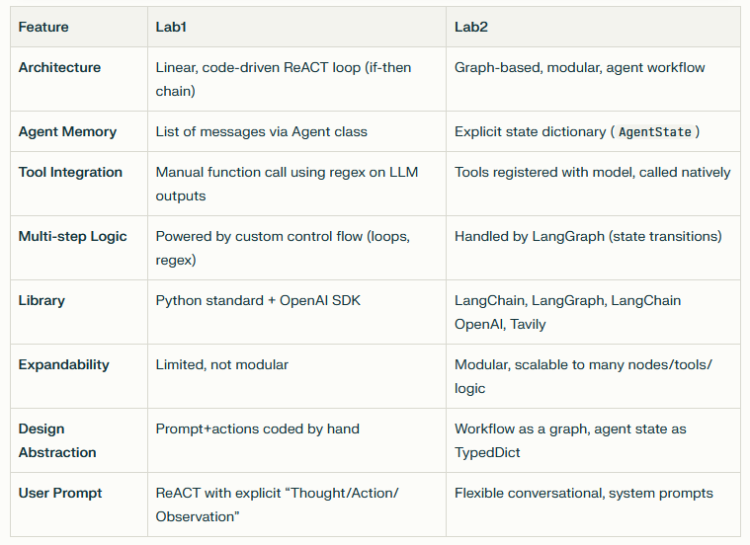

Slide 19
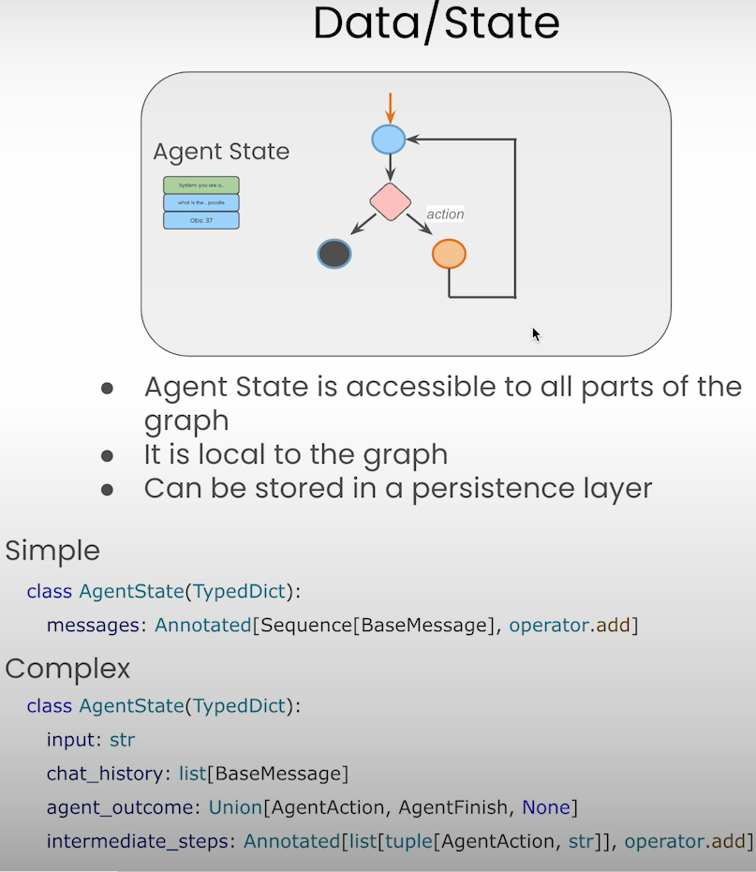

Slide 20
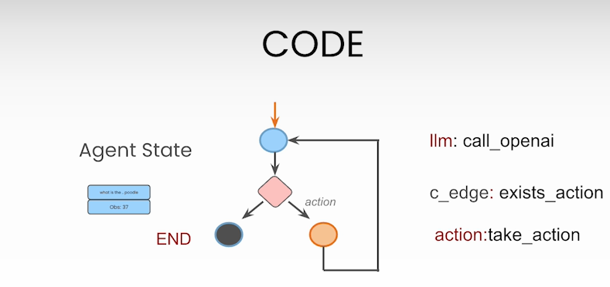
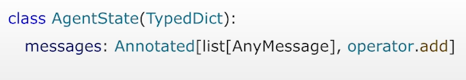
State

Slide 21
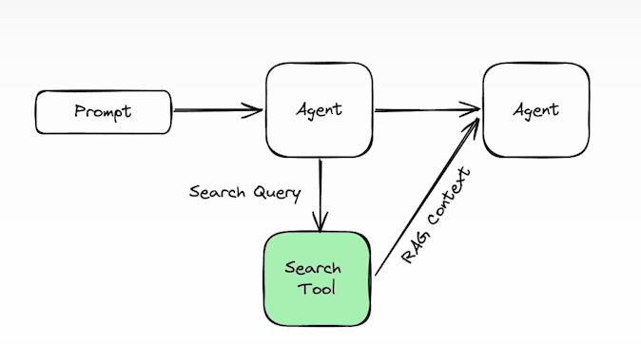
Agentic Search Tools

Slide 22
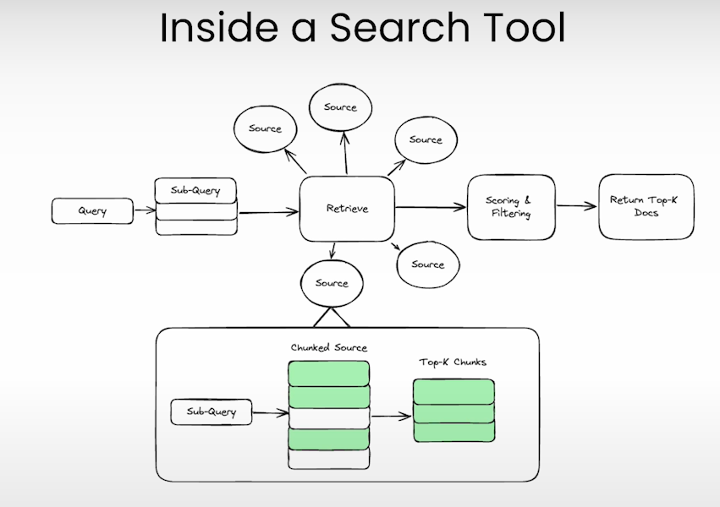

Slide 23
Persistence and Streaming
It enables memory of past interactions, decisions, and external tool invocations.
For search or research-based agents, persistent state allows threaded, context-rich conversations where the AI naturally understands follow-up questions and maintains logic, rather than treating each turn in isolation.
Streaming refers to the real-time, incremental processing and delivery of results from an agent rather than waiting for an all-at-once response.

Slide 24
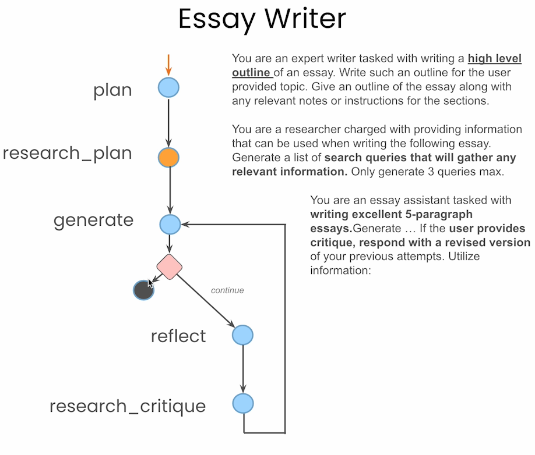

Slide 25
Example Use Case
Suppose state['task'] is: "Research the latest trends on electric vehicles"
The system prompt (PLAN_PROMPT) might instruct the LLM to produce a step-by-step plan to perform this research.
The LLM might respond with something like:
"1. Identify key topics on electric vehicles\n2. Search recent articles and news\n3. Summarize findings\n4. Prepare a report"
The plan_node returns { "plan": "1. Identify ... 4. Prepare report" }
Our agent graph can then use this plan to call corresponding nodes or tools.

Slide 26
Scope of Pydantic in the context of Agentic AI
1. Structured Data Validation and Parsing
Pydantic models provide a concrete, type-safe way to define and validate the structure of the data flowing through an agent workflow. This includes:
Input state (such as a user query, research task, or system configuration)
Node outputs (like a plan, list of queries, summary draft, critique)
Tool and LLM function arguments and returns
By defining your state or outputs using a Pydantic model, you guarantee at every step that your agent nodes receive and emit data in a known, expected, and validated format—helping prevent runtime errors and data corruption.

Slide 27
2. Inter-Node Communication and State Management
Enable reliable passing of data between agent nodes (such as moving from planning to research, then to generation, critique, and so on).
3. Serialization for Persistence and Checkpointing
Easy serialization and deserialization (e.g., to/from JSON), essential for saving and restoring agent state and outputs.
4. Schema-Aware LLM and Tool Integration
Many LLM frameworks, including LangChain, allow schema-based function calling or structured output from LLMs and tools.
5. Ease of Extension and Maintainability

Slide 28
The Whole Process as a Prompt through commercial GenAI Interfaces
Instead, the LLM “acts” as all the agents at once, inferring and simulating multi-step processes in a monolithic, “one big brain” fashion.
You get consistent, repeatable outputs with less variability.
The workflow is reusable for many users, not just ad-hoc to a single session.
Transparency & Auditability: Each agent’s logic, input, and output is visible and can be saved, debugged, and improved.

Slide 29
AutoGen Framework
Is a framework specialized for LLM-powered conversational agents (from Microsoft/other open-source projects).
Communication is through message-passing and dialog turns, abstracting underlying step orchestration.
Agents can be system/LLM, tool, function, or human proxies.
Orchestration is via callback/event rules (not a static graph), focusing more on mimicking “humanlike” conversations and dynamic intentions.
Best for chat-centric or negotiation-style workflows less rigid than a Directed Acyclic Graph (DAG), more “organic.”
No explicit, persistent check pointing/backing store by default (but you can export dialogue histories).

Slide 30
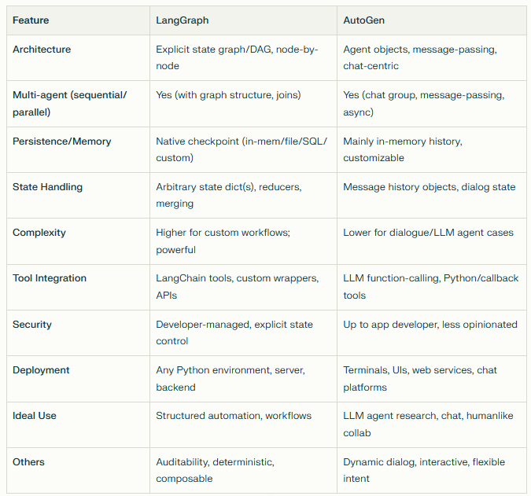

Slide 31
LangGraph:
Best for complex, multi-stage, auditable automation where you want determinism, checkpointing, and control, even in non-chat contexts. Great for production pipelines and orchestration. (If you have a very structured, multi-tool business workflow, LangGraph is likely superior)
AutoGen:
Best for dynamic, interactive, conversational multi-agent demos, “AI chats with itself,” or LLM research where imitation of humanlike collaboration is the main focus.
(If you want an LLM-driven “chat amongst AI agents” with flexible, natural dialog, exploration, or collaboration, AutoGen is a great choice)

Slide 32
CrewAI
After mastering LangChain for single agents and LangGraph for orchestrated workflows, and understanding AutoGen for multi-agent chat-driven collaboration, CrewAI steps in for scalable multi-agent teamwork beyond simple chat or graph flows.
It integrates lessons from both: structured task flows and natural conversational dynamics, with a focus on distributed collaboration and operational scalability.

Slide 33
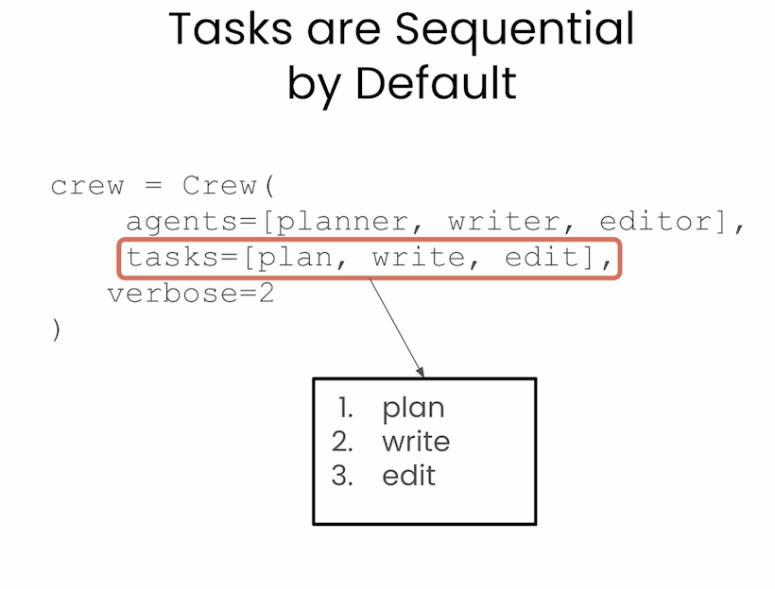

Slide 34
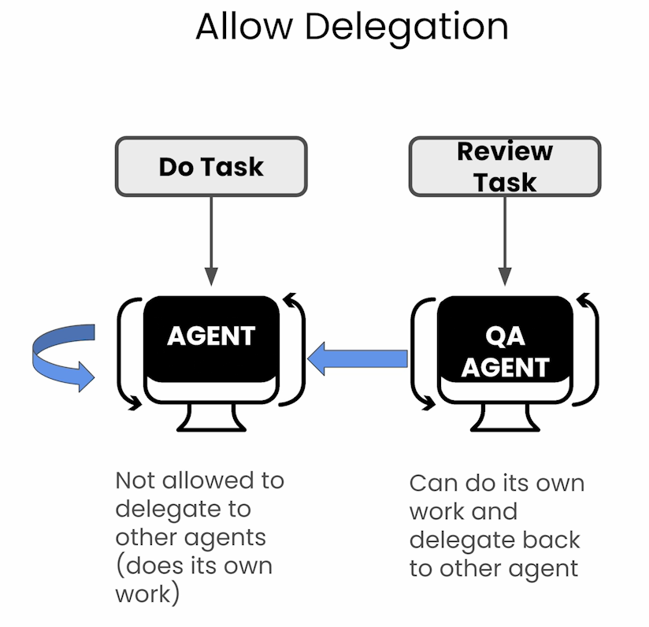

Slide 35
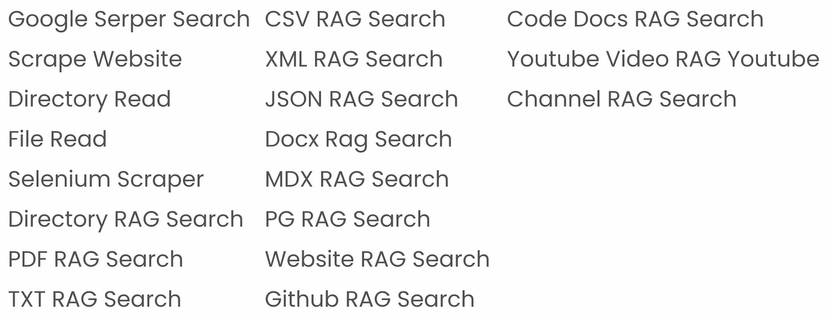

Slide 36
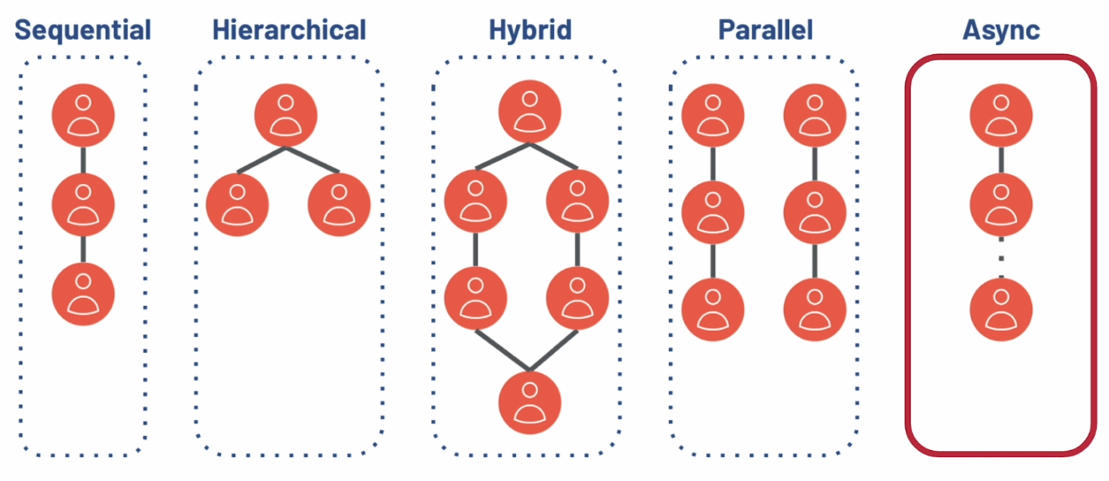

Slide 37
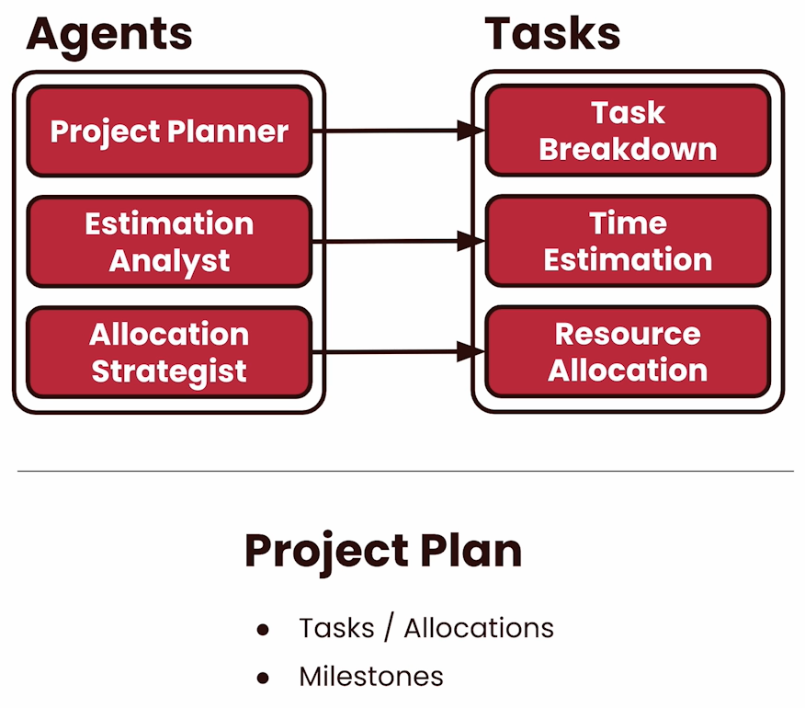

Slide 38
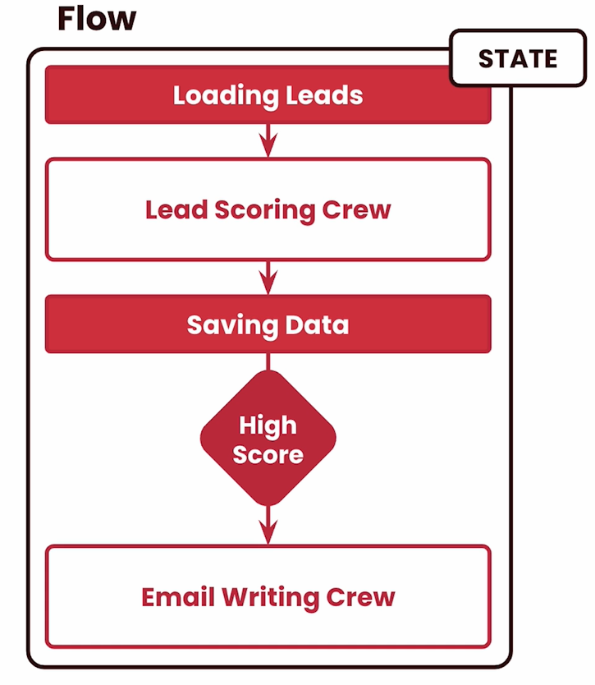

Slide 39
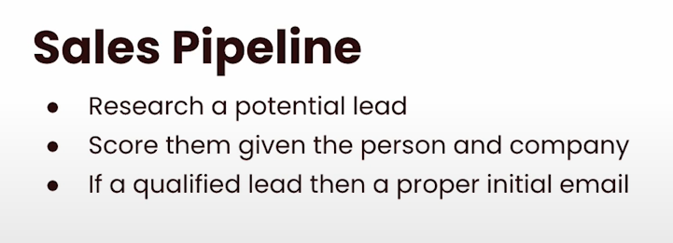

Slide 40
Why MCP?
Models are only as good as the context given to them

Slide 41
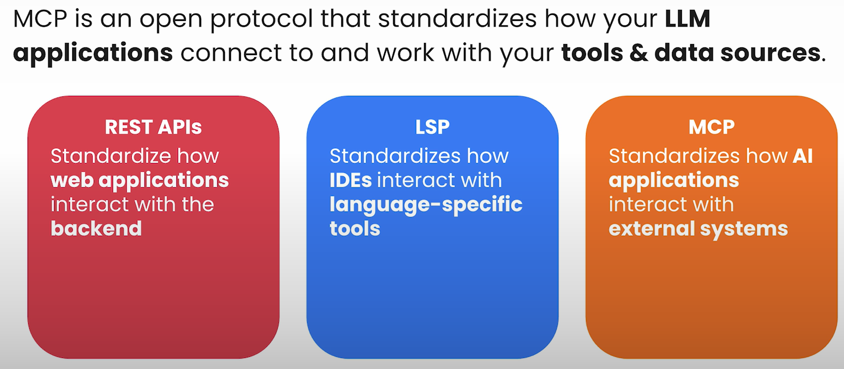

Slide 42
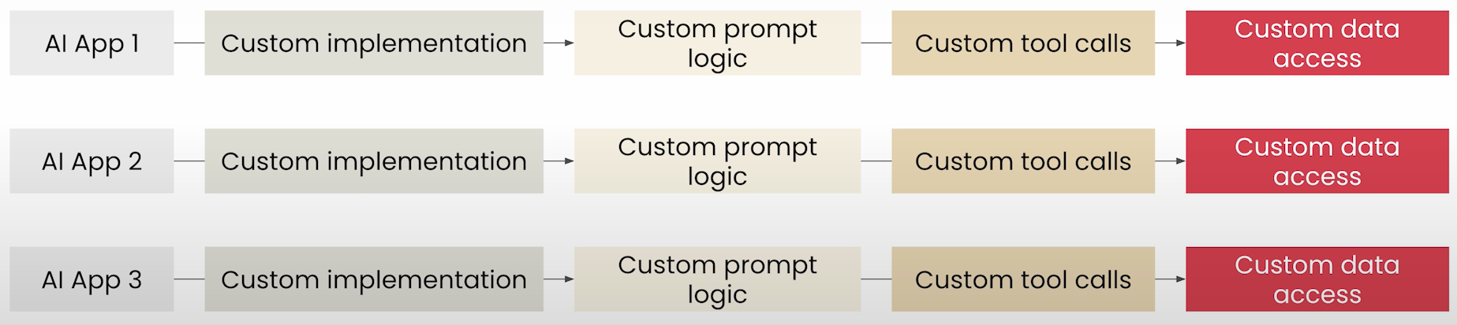
Without MCP: Fragmented AI Development

Slide 43
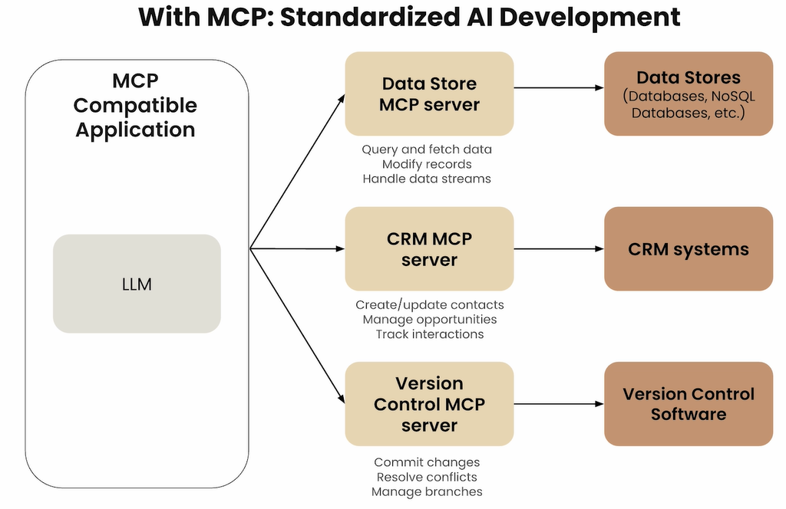

Slide 44
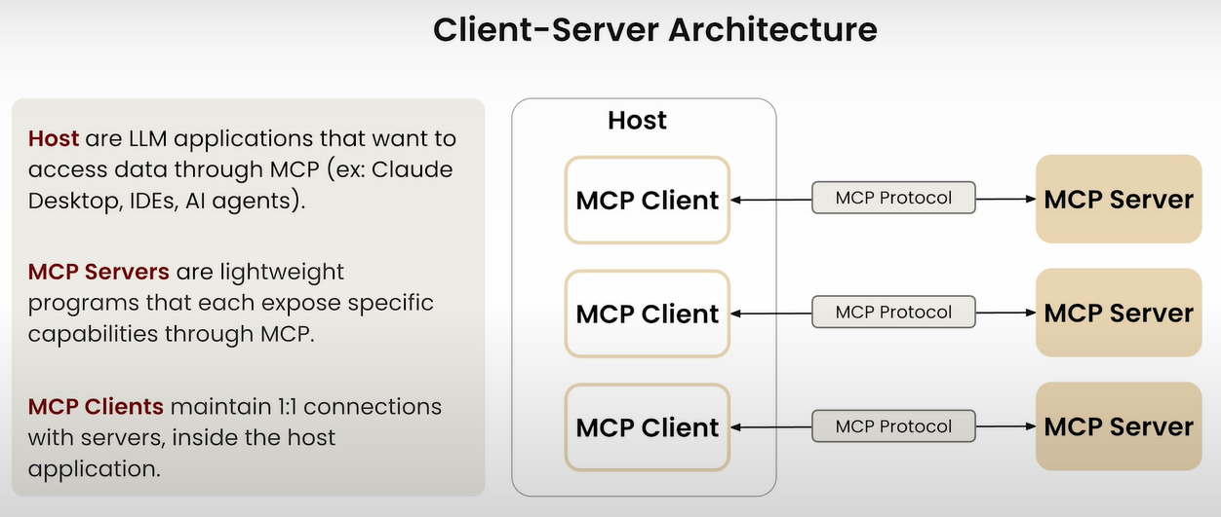

Slide 45
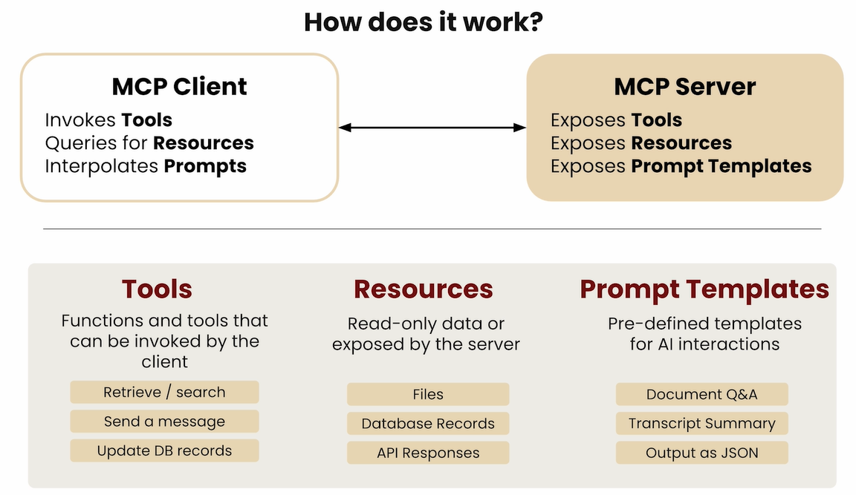

Slide 46
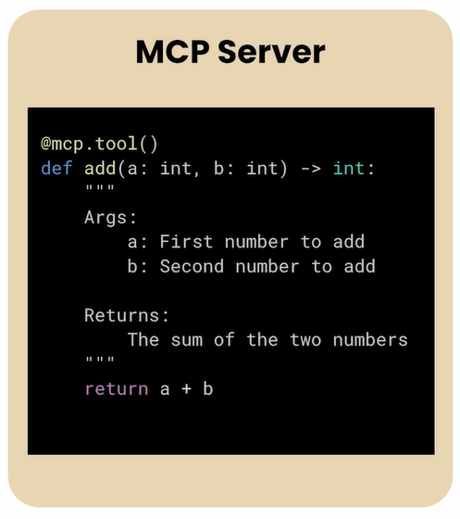
Defining a Tool (Python MCP SDK)

Slide 47
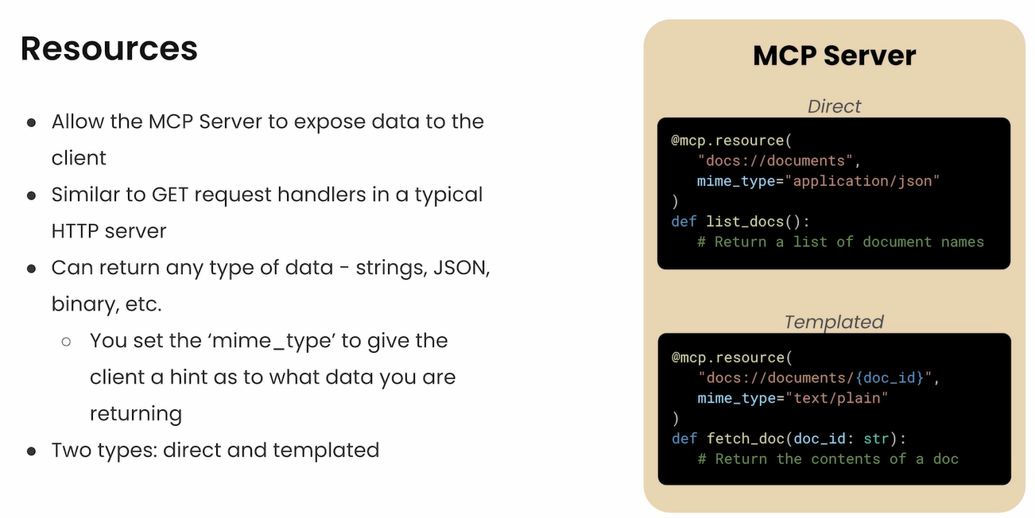

Slide 48
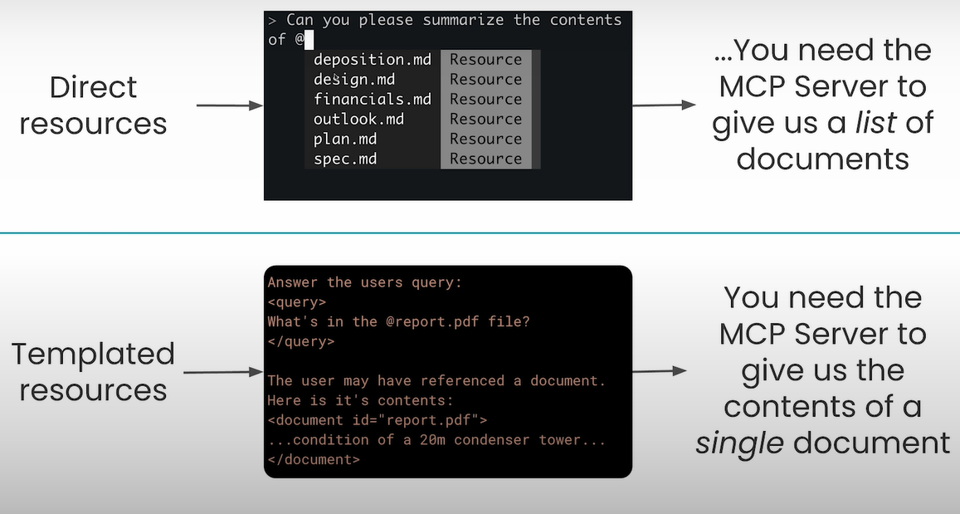

Slide 49
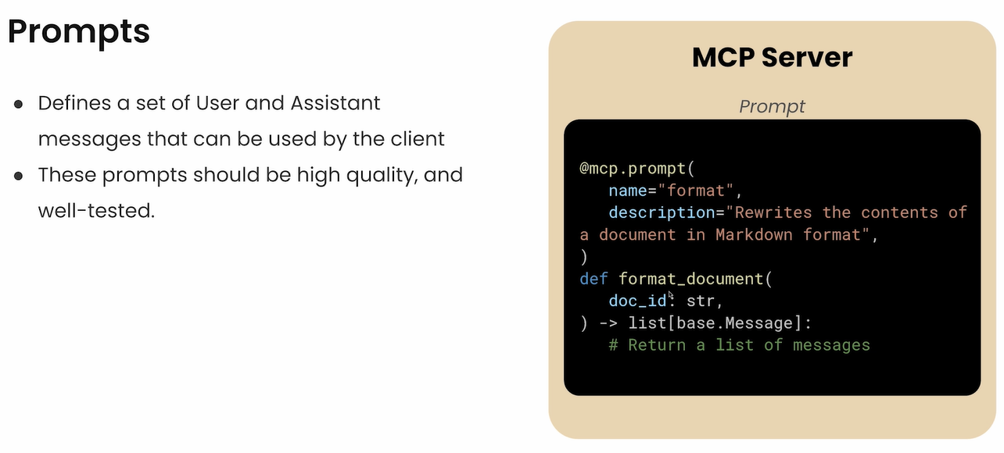

Slide 50
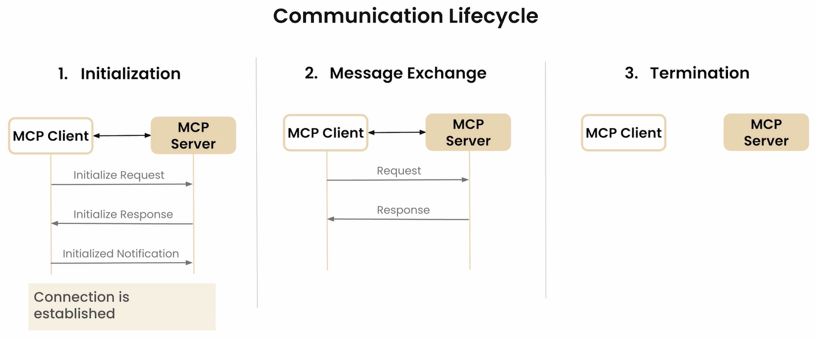

Slide 51
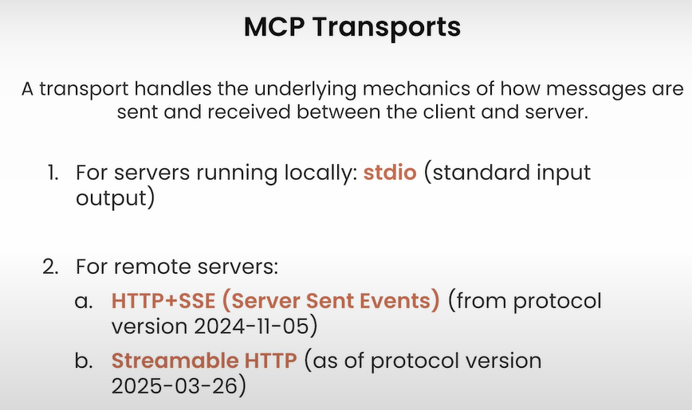

Slide 52
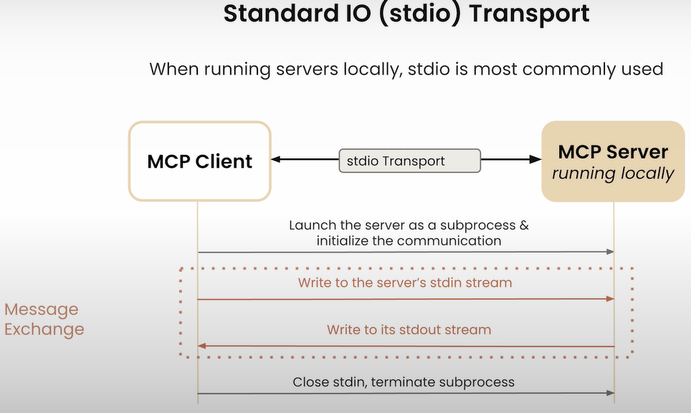

Slide 53
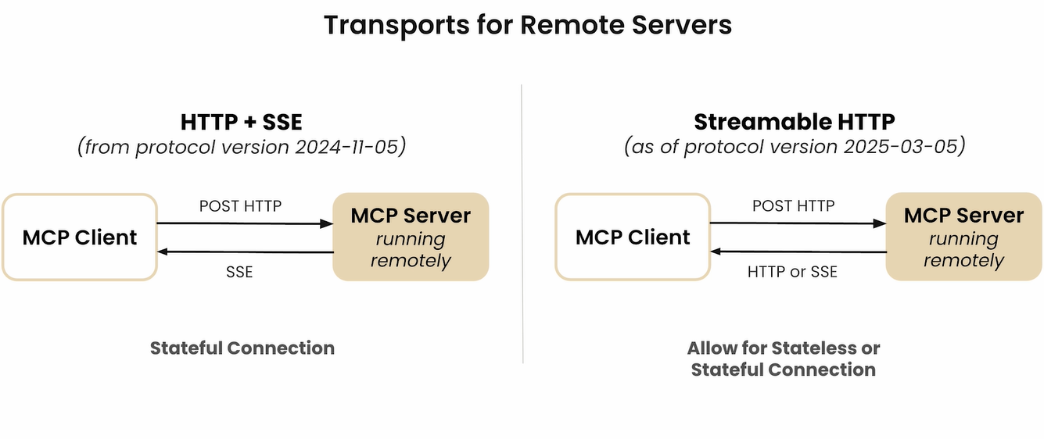

Slide 54
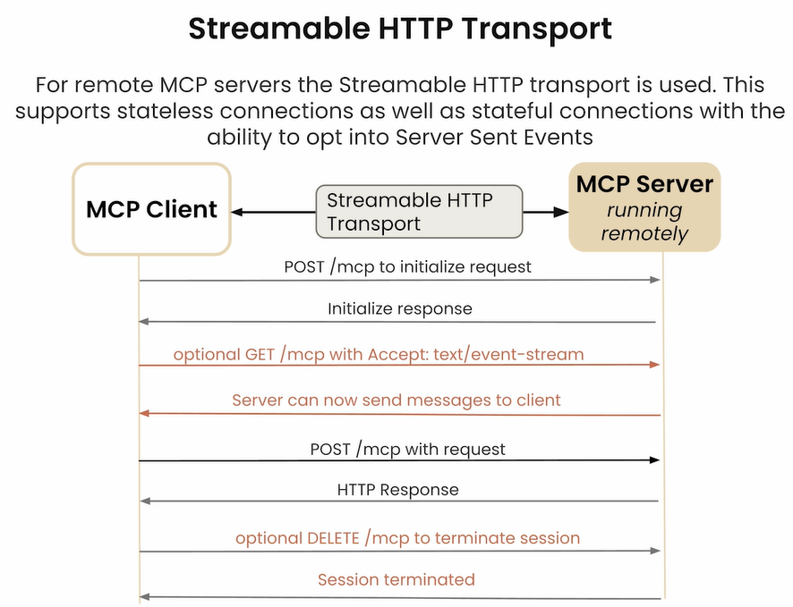

Slide 55
Thank You
https://learnaiwithanand.com
dranand.scs@gmail.com

